Slide 1
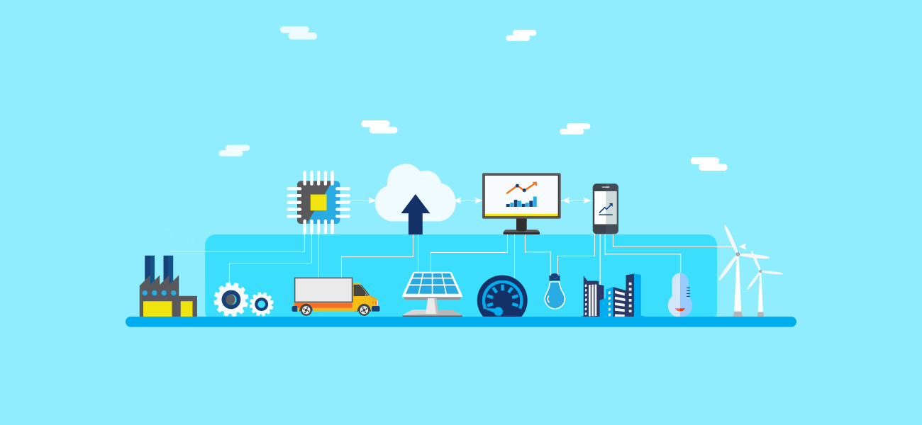
Internet Of Things
By: Sarathy(764934)

Slide 2
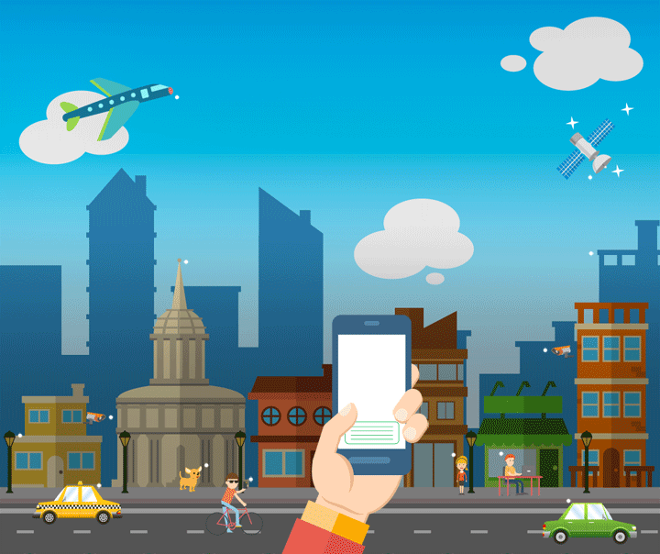
Roadmap
What is IOT?
Need for IOT
History of IOT
How it works?
Stages of IOT
Pros and Cons
Applications
Hands-on (Websites)

Slide 3
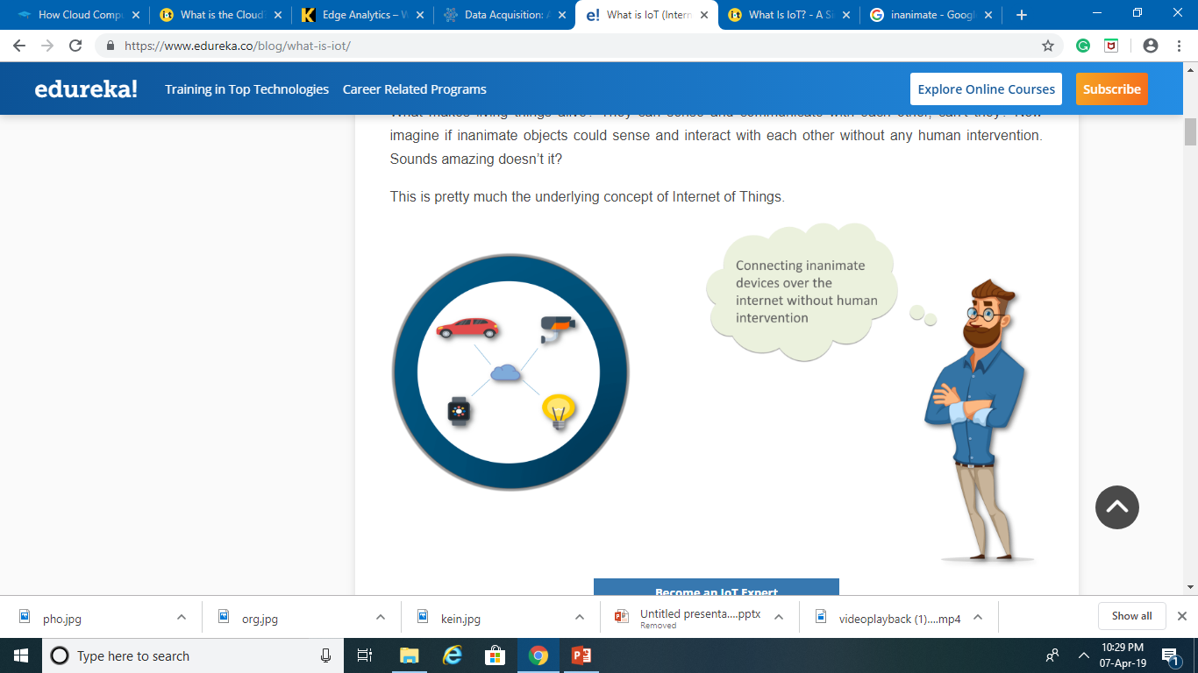
What is IoT?
The Internet of Things (IoT) is the network of physical objects "things" embedded with electronics, software, sensors, and network connectivity, which enables these objects to collect and exchange data.
IoT allows objects to be sensed and controlled remotely across existing network infrastructure, creating opportunities for more direct integration between the physical world and computer-based systems, and resulting in improved efficiency, accuracy and economic benefit.

Slide 4
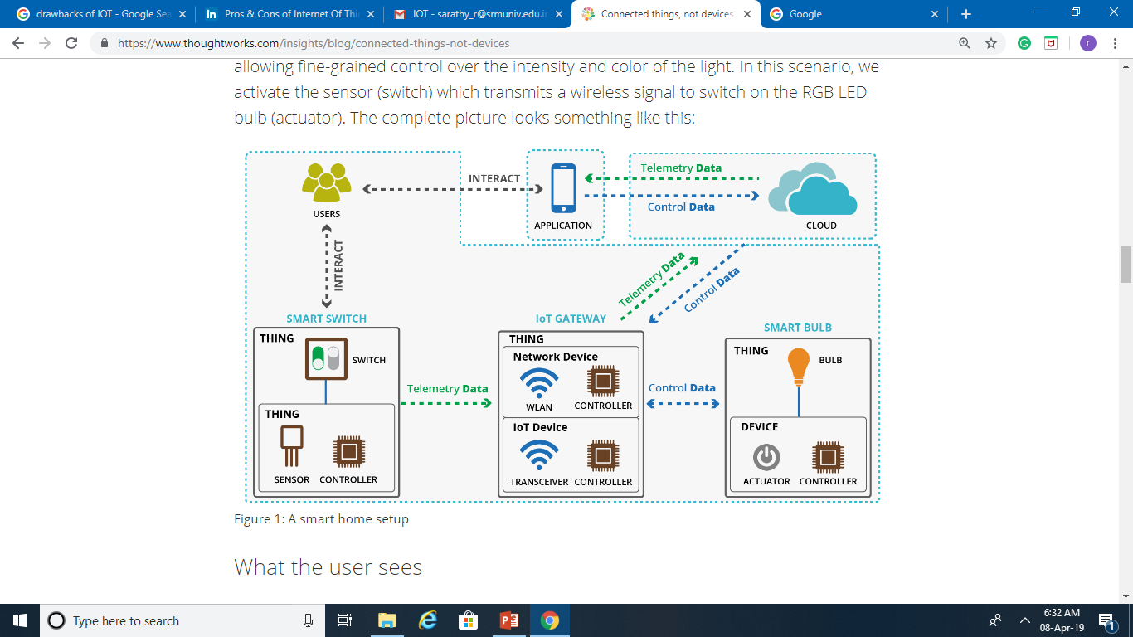
Difference between things and devices
This is an example pf basic IOT architecture, the lightbulb is the thing and it contains a device inside that transforms it from a 'dumb thing' into a 'smart thing'. In addition, we have another smart thing which is the smart switch. It also has an internal device inside then wirelessly transmits the 'press' to the smart bulb over the selected IoT protocol of choice (ZigBee, Bluetooth, WiFi etc.).

Slide 5
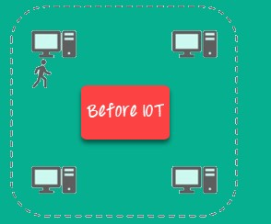
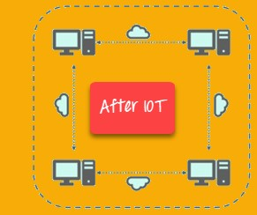
Need for IOT

Slide 6

History of IoT
Kevin Ashton, co-founder and executive director of the Massachusetts Institute of Technology’s Auto-ID Center – which was then replaced by the more research-oriented Auto-ID Labs in 2003 – who coined the term “Internet of Things.”
Radio-frequency identification (RFID) was seen as a prerequisite for the IoT at that point. If all objects and people in daily life were equipped with identifiers, computers could manage and inventory them. Besides using RFID, the tagging of things may be achieved through such technologies as near field communication, barcodes, QR codes, bluetooth, and digital watermarking.

Slide 7
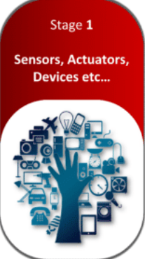
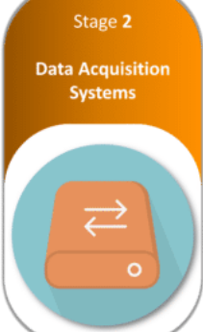
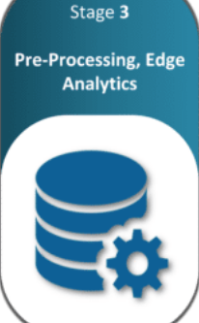
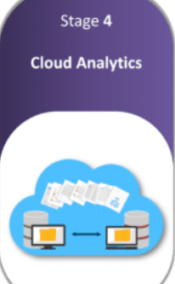
How iot works?

Slide 8
Stage 1 : Sensors and Actuators
A thing in the context of “Internet of Things”, should be equipped with sensors and actuators thus giving the ability to emit, accept and process signals. When something is connected to the internet, that means that it can send information or receive information, or both. This ability to send and/or receive information makes things smart, and smart is good. In the Internet of Things, all the things that are being connected to the internet can be put into three categories:
Things that collect information and then send it (Sensor)
Things that receive information and then act on it (Actuator)
Things that do both (Transducer)

Slide 9
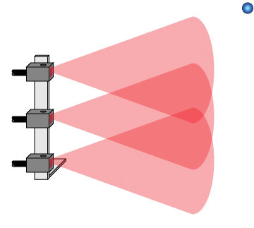
1. Sensors
Sensors collect data from the environment or object under measurement and turn it into useful data. Think of the specialized structures in your cell phone that detect the directional pull of gravity—and the phone's relative position to the “thing” we call the earth—and convert it into data that your phone can use to orient the device.
Examples are Simple sensors – temperature, pressure.

Slide 10
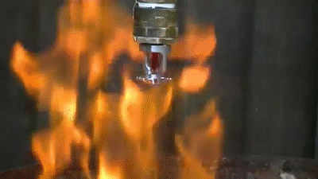
2.Actuators
Actuators can intervene to change the physical conditions that generate the data. An actuator might, for example, shut off a power supply, adjust an air flow valve, or move a robotic gripper in an assembly process. We’re all very familiar with machines getting information and then acting. Your printer receives a document and it prints it. Your car receives a signal from your car keys and the doors open.

Slide 11
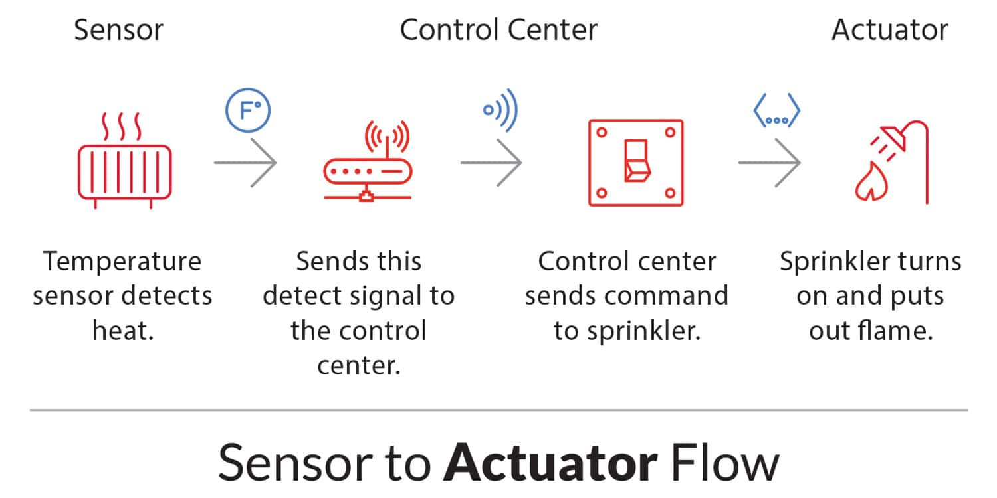
3.Transducer
A transducer is any device used to convert energy from one form to another; typically when converting input energy into output energy. For transduction to occur, a change from one form of energy must also take place, such as a conversion from mechanical to electrical energy or vice versa.
Example: Antenna which can receive as well as transmit data is also a type of transducer.

Slide 12
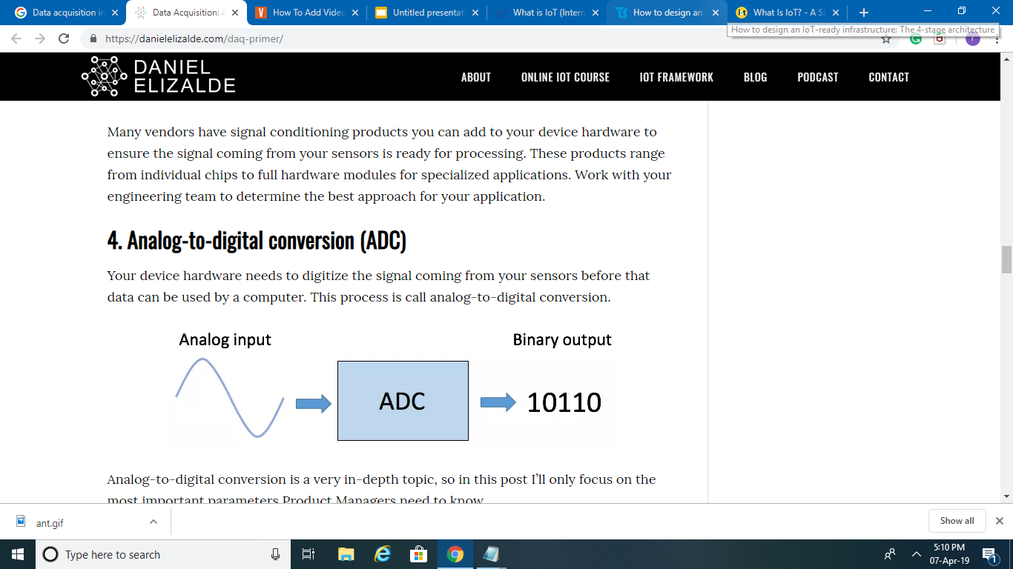
Stage 2: Data acquisition
Data acquisition systems (DAS) perform these data aggregation and conversion functions. The DAS connects to the sensor network, aggregates outputs, and performs the analog-to-digital conversion. The Internet gateway receives the aggregated and digitized data and routes it over Wi-Fi, wired LANs, or the Internet, to Stage 3 systems for further processing.

Slide 13
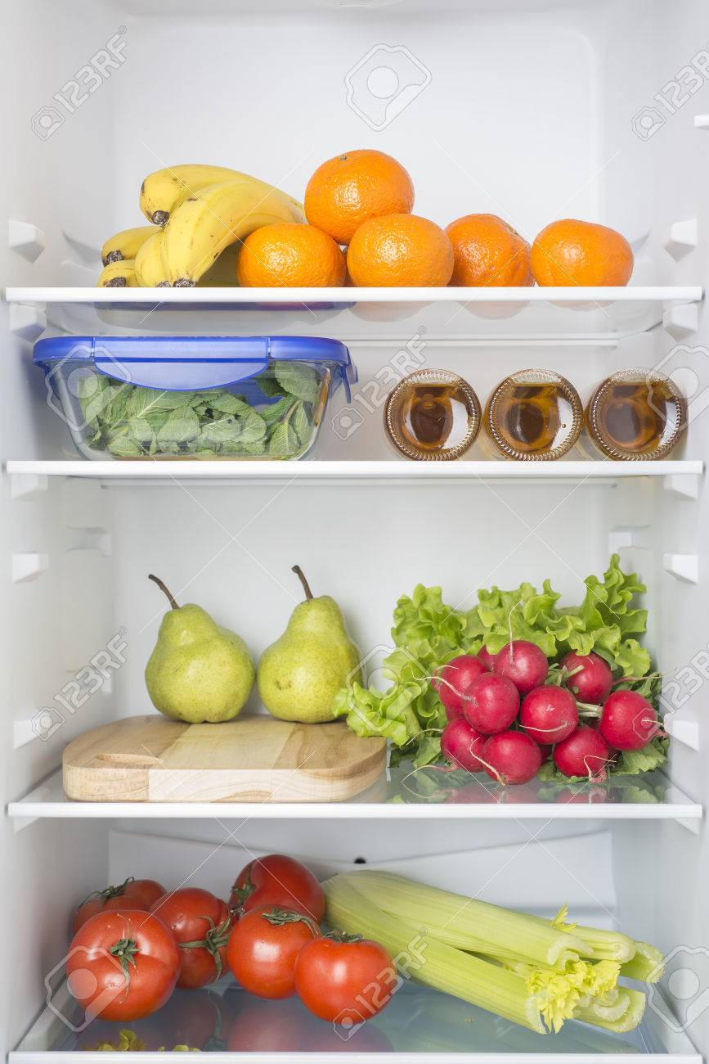
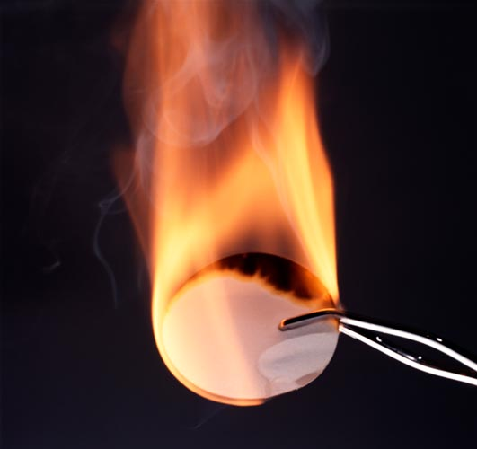
Example
INT : 15 secs
INT : 3 secs
(a) Storage of vegetables
(b) White phosphorous

Slide 14
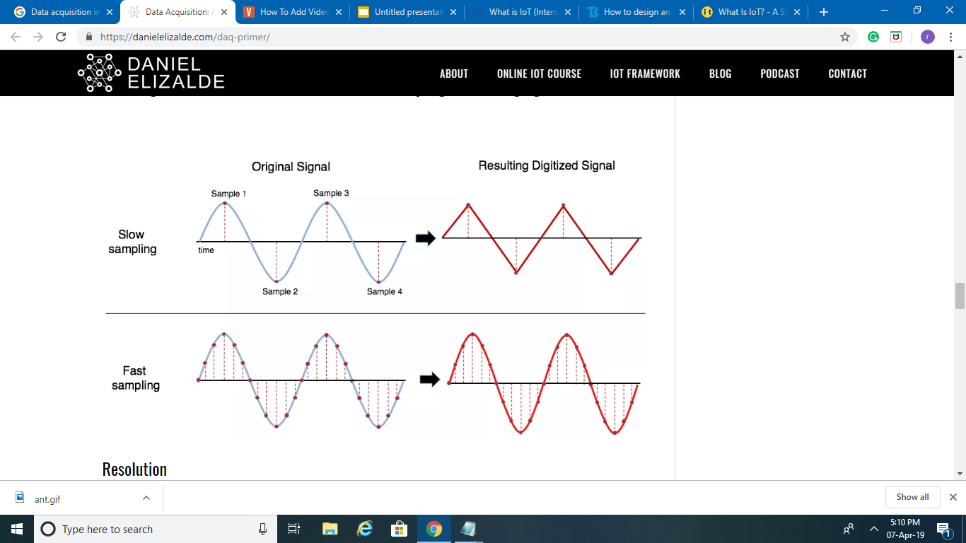
Sampling rate
Sample rate refers to how often is the ADC taking samples of the analog signal. To accurately reproduce the frequency content of an analog signal, it mainly depends upon the use-case of the particular device.

Slide 15
Stage 3: Edge analytics
Once IoT data has been digitized and aggregated, it may require further processing before it enters the data center, this is where Edge Analytics comes in. It is an approach to data collection and analysis in which an automated analytical computation is performed on data at a sensor, network switch or other device instead of waiting for the data to be sent back to a centralized data store. This involves collecting data, preparing data, selecting the algorithms, training the algorithms on a continuous basis, deploying/redeploying the models etc.
Giving the decision making power to the device
Reduce latency
Low scalability of data

Slide 16
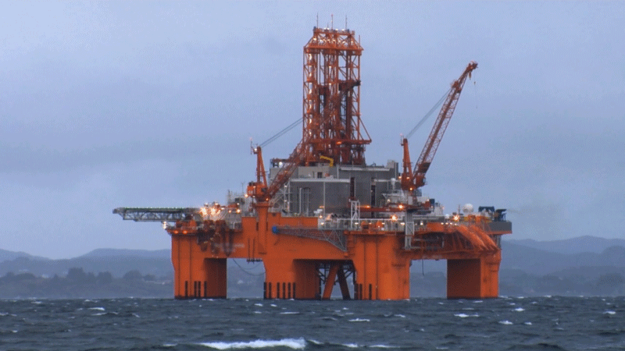

Example :Without Edge Analytics

Slide 17
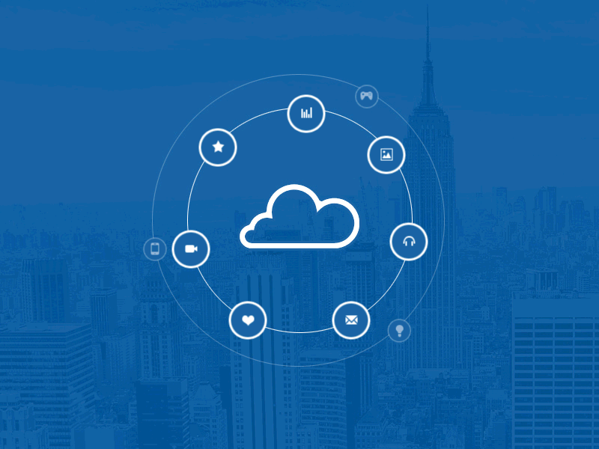
Stage 4: Cloud storage and analytics
Data that needs more in-depth processing, and where feedback doesn't have to be immediate, gets forwarded to physical data center or cloud-based systems, where more powerful IT systems can analyze, manage, and securely store the data.
They are available as cloud based and standalone platforms and are available from many companies -large and small.
Examples
Amazon Web services (AWS)
IBM Watson Bluemix
Microsoft Azure
Thing Worx

Slide 18
Pros and Cons
PROS
Easy access of information
Communication between devices is more transparent and easy.
Reduces both time and money
Increased efficiency
CONS
Compatibility
Complexity
Privacy and Security

Slide 19
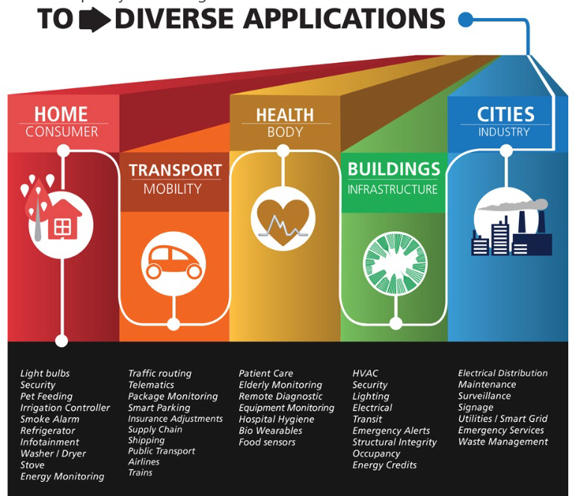
Few Applications of IoT

Slide 20
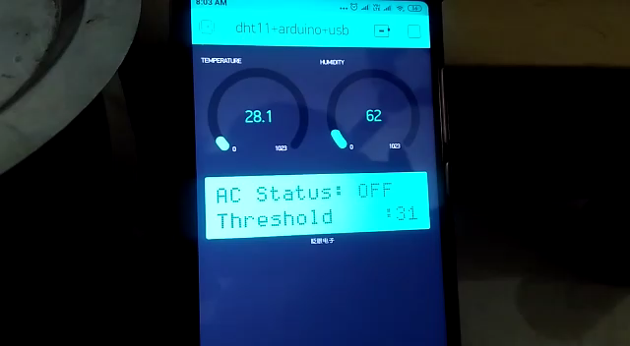
Demo

Slide 21
Ex 1 : IOT in daily life

Slide 22
Ex 2 : IOT in emergency

Slide 23

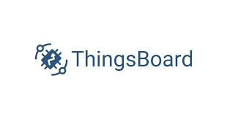
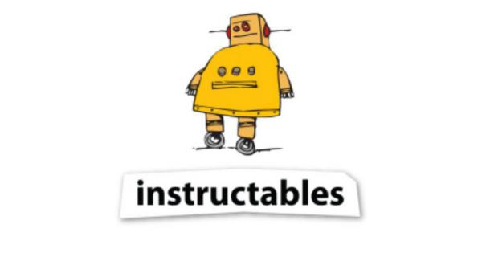

Hands-on

Slide 24

Known so far

Slide 25
References
https://en.wikipedia.org/wiki/Internet_of_Things
https://internetofthingsagenda.techtarget.com/definition/Internet-of-Things-IoT
https://www.iotforall.com/what-is-iot-simple-explanation/
https://www.youtube.com/watch?v=Q3ur8wzzhBU

Slide 26
Queries?

Slide 27
THANK YOU

